Slide 1
Unemployment:
Types
Calculating Rates
Implications

Slide 2
Types of unemployment
Frictional Unemployment: When people take time to find a job.
Example: When someone is laid off, changes jobs, or need time to find a job after graduating from school.

Slide 3
Types of unemployment
Structural Unemployment: When workers’ skills do not match what jobs are available for (structure of) the current economy.
Causes of Structural Unemployment:
New Technology
New Resources
Changes in Consumer Demand
Globalization- Shift to foreign markets
Lack of Education

Slide 4
Types of unemployment
Seasonal Unemployment: When industries slow or shut down for a season of the year to make seasonal shifts in production schedules and people lose their jobs.
Examples: When people who sell Halloween costumes or Christmas trees are out of a job because the holiday has passed.

Slide 5
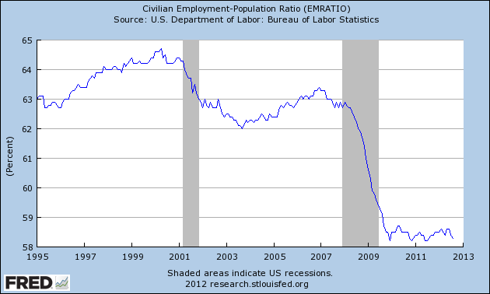
Types of unemployment
Cyclical Unemployment: Unemployment that goes up during times of economic turmoil, and goes down during times of economic prosperity.
Examples: A recession causes people to save more and spend less, because of this companies may slow down production and lay off workers.

Slide 6
The unemployment rate
The rate of unemployment is a great way to measure the health of your economy.
The Unemployment Rate is the percentage of a nation’s labor force that is unemployed.
The Labor Force is NOT every citizen.
The Labor Force is made up of individuals 16 and older who either have a job or are actively seeking for a job.
The Unemployment Rate is adjusted to account for seasonal unemployment so that it is more accurately reflective of the health of the economy.

Slide 7

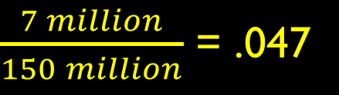
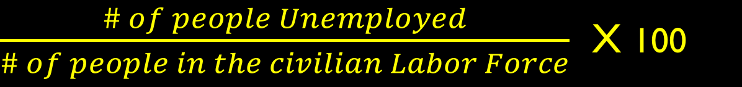
Calculating the unemployment rate
To find the Unemployment Rate, we use the following equation:
For Example, if there are 7 million unemployed people. And there are 150 million people in the civilian labor force, we have the following rate of Unemployment:
$\frac{\# of people Unemployed}{\# of people in the civilian Labor Force}$ X 100
$\frac{7 million}{150 million}$ = .047
$$.047 X 100=4.7\% Unemployment$$

Slide 8
Goal: Full employment
Zero Unemployment is always impossible in a market economy.
But we strive for Full Employment where no cyclical unemployment exists in the economy.
An unemployment rate of about 4-6 percent is normal during full employment.

Slide 9

Aspects of full employment
Full Employment means everyone who wants a job has a job.
But some of those people may be Underemployed meaning they are working at a job below their skillset.
Example: An individual with a Master’s degree, unable to find work in their field, and settling for a job at Publix.

Slide 10
Aspects of full employment
Additionally, some people give up trying to find work, especially during a long recession.
When people stop looking for jobs and rely on other means to sustain themselves, they are considered a Discouraged Worker.
These people are NOT actively seeking a job and are therefore not included in the Unemployment Rate.
If Underemployed and Discourage Workers were included in the Unemployment Rate, it would be much higher.

Slide 11

Which Unemployment rate is the real unemployment rate?

